Slide 1


Amazon
Sales Analysis

Slide 2
History Of Amazon
Amazon is a multinational e-commerce and technology company founded by Jeff Bezos in 1994. Initially an online bookstore, it has grown into the world’s largest online retailer, offering everything from electronics to cloud computing services (AWS). Known for its customer-centric approach, Amazon dominates the global e-commerce market through innovations like one-day delivery, AI-driven recommendations, and smart devices like Alexa
Amazon also operates a vast logistics network, ensuring efficient and fast deliveries worldwide. Additionally, it has expanded into digital streaming (Prime Video, Amazon Music) and artificial intelligence, making it a leader in multiple industries beyond e-commerce.

Slide 3
Business Questions
What is the impact of different discount percentages on total sales and revenue?
Are there any price ranges where customer ratings drop significantly?
What is the correlation between rating count and revenue?
Do higher-rated products generate more revenue compared to lower-rated ones?
Which product categories have the highest repeat purchases?

Slide 4
What is the impact of different discount percentages on total sales and revenue?
Revenue Calculation:
The revenue is calculated using:
Ensures that the revenue reflects the effect of discounts on sales.
Analysis of Discount Impact:
A bar chart is used to visualize the relationship between discount percentage and revenue

Slide 5
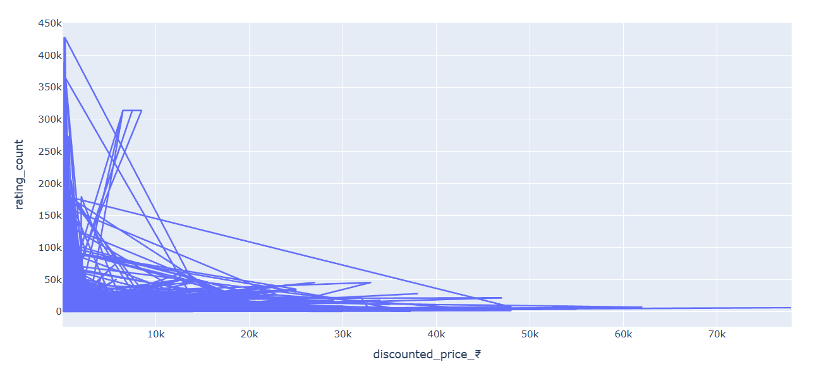
Are there any price ranges where customer ratings drop significantly?
As the price invreases rating also decreases

Slide 6
What is the correlation between rating count and revenue
As the rating increases, revenue also increases initially. However, beyond a rating of 4.75, revenue starts to decline, indicating that customers tend to prefer mid-priced goods over high-priced ones. This suggests that while quality is important, excessively high-priced products may not be as appealing to buyers, possibly due to budget constraints or diminishing perceived value.

Slide 7
Do higher-rated products generate more revenue compared to lower-rated ones?
Products with low and extremely high ratings generate less revenue, whereas mid-rated products (ratings between 3.0 and 4.75) drive the highest revenue. This forms a Gaussian distribution, indicating that customers tend to prefer products with balanced ratings over poorly rated or overly high-rated ones, possibly due to price-performance considerations.

Slide 8
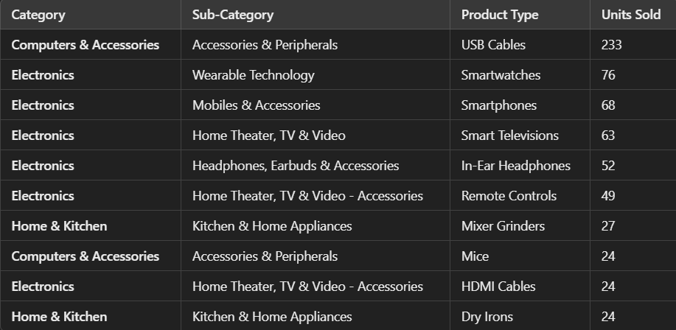
Which product categories have the highest repeat purchases?

